Slide 2
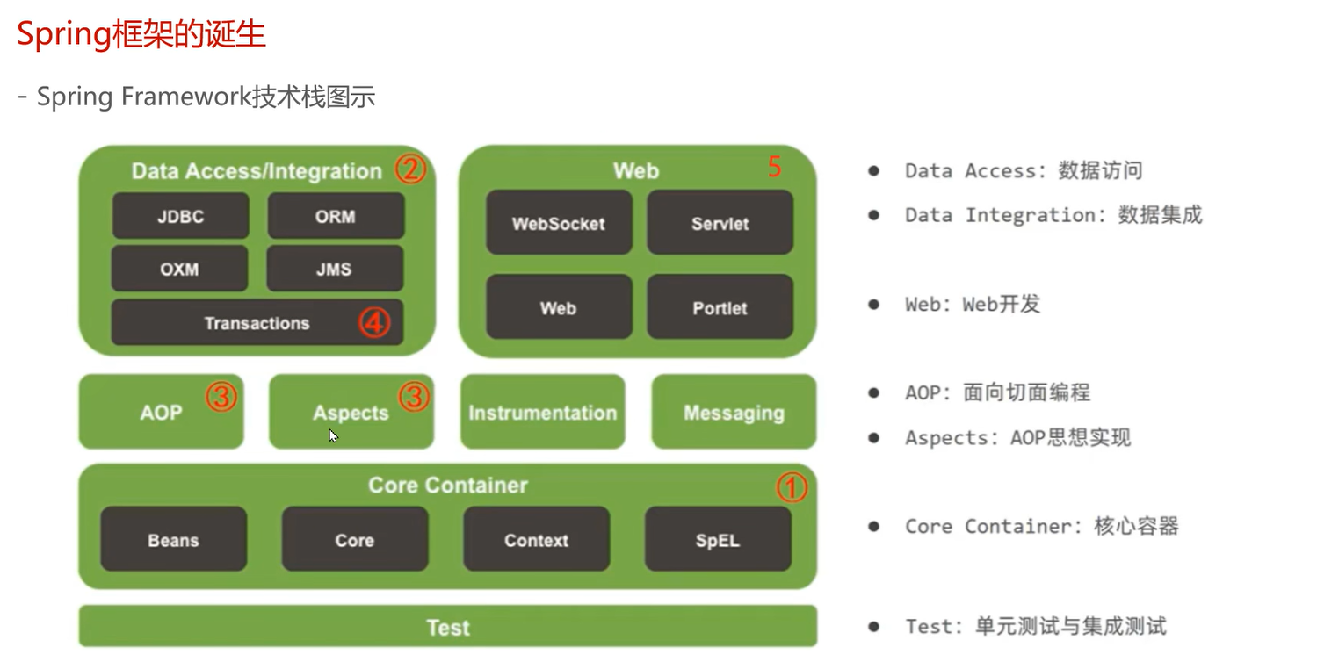

Slide 3
Bean Factory

Slide 4
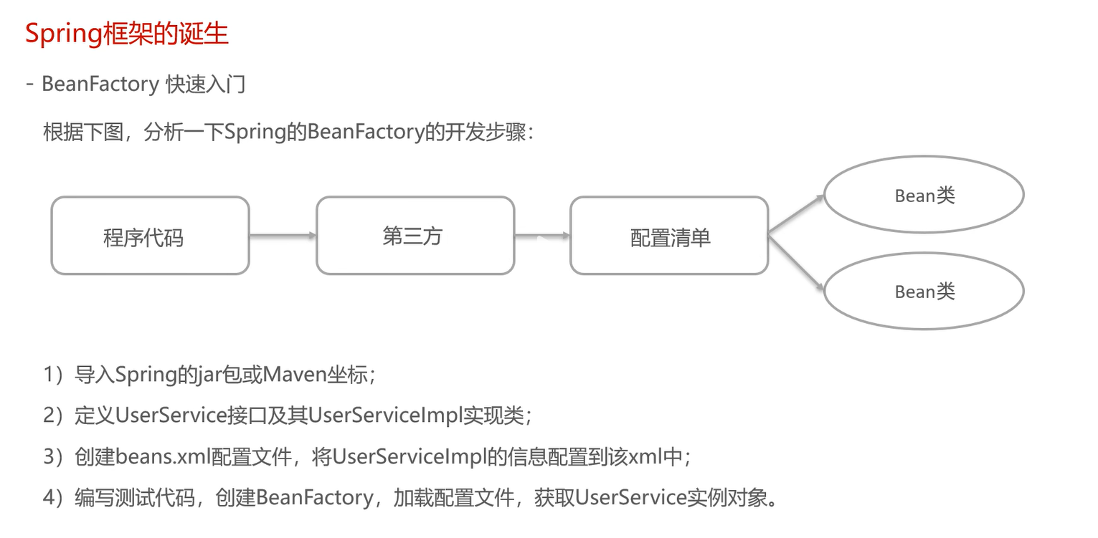

Slide 5
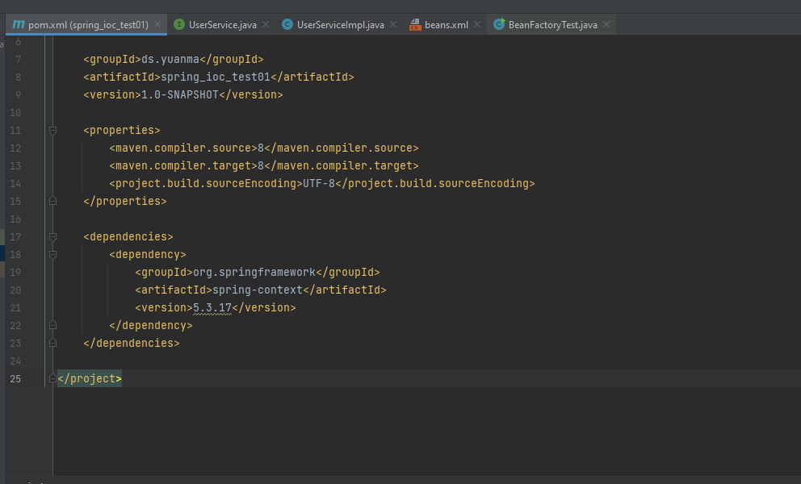

Slide 6
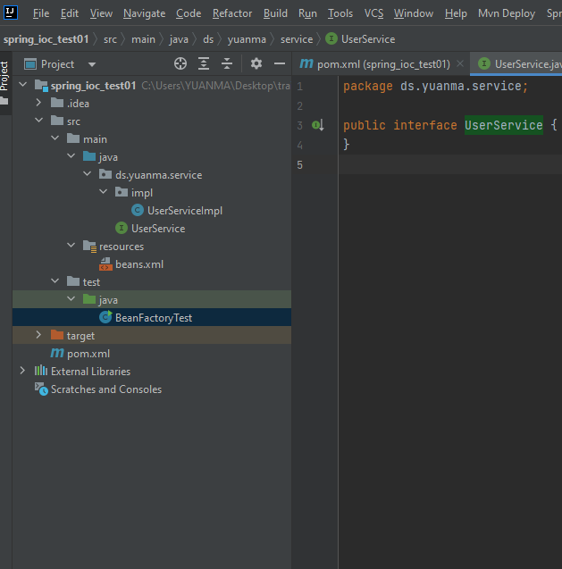
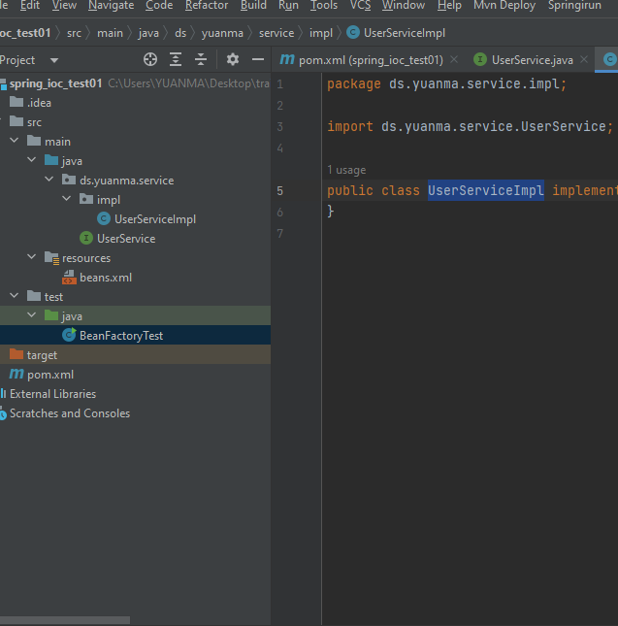

Slide 7
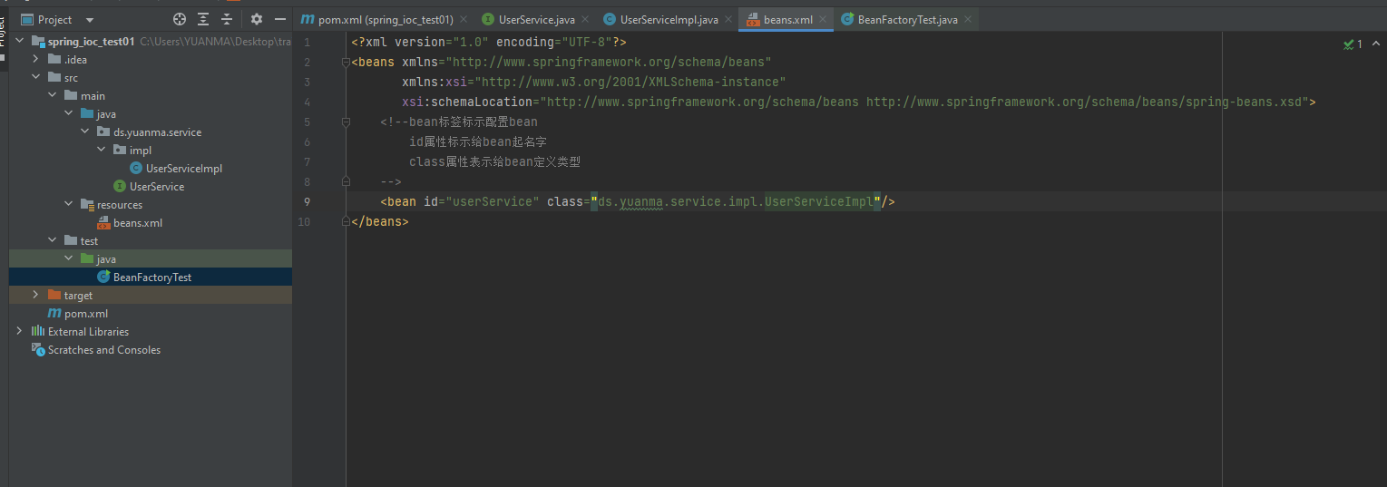

Slide 8
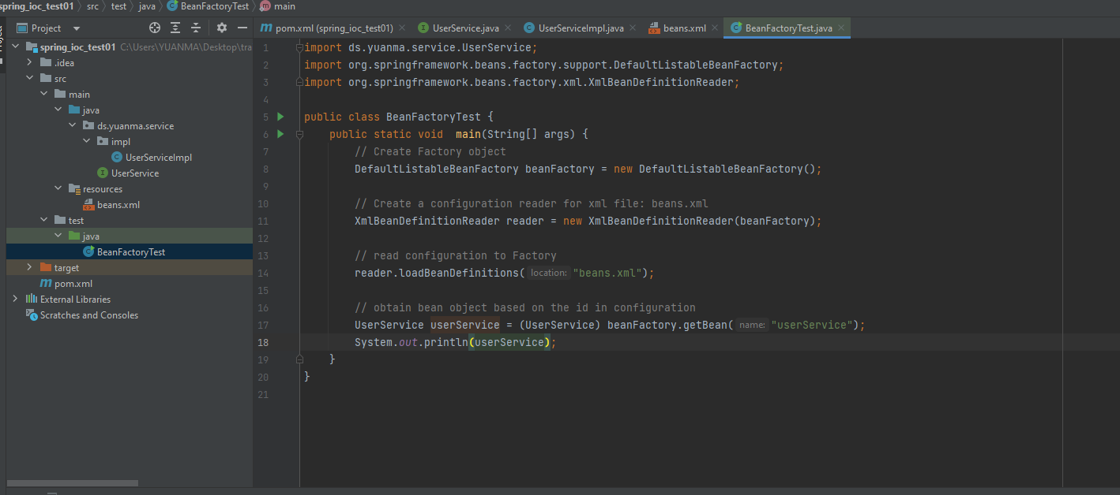
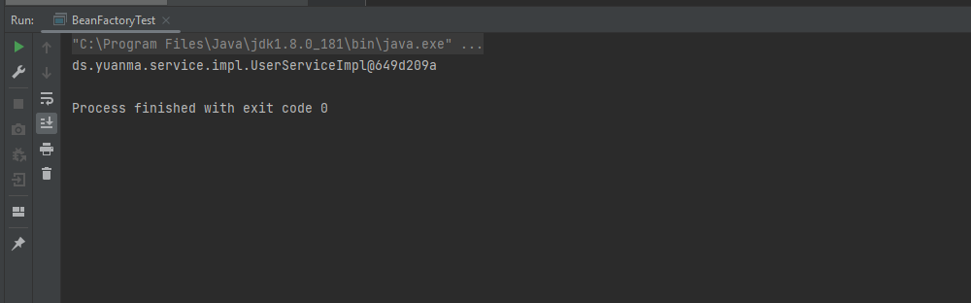

Slide 9
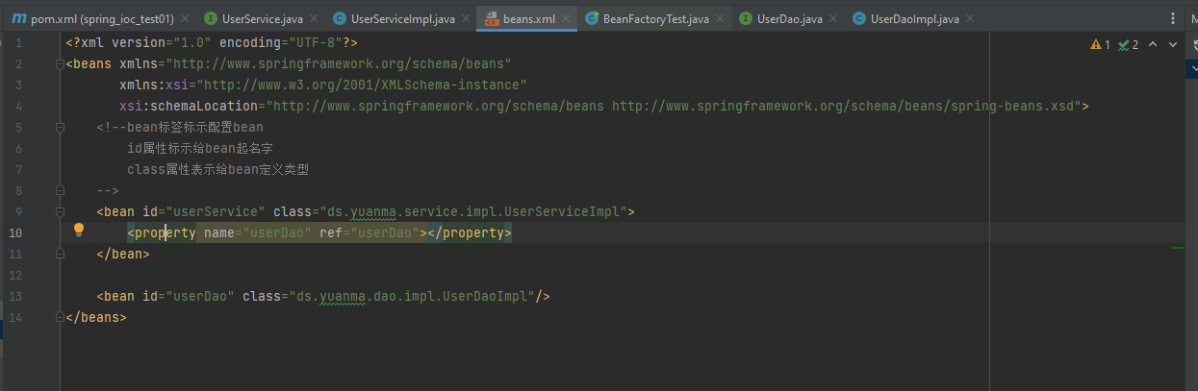
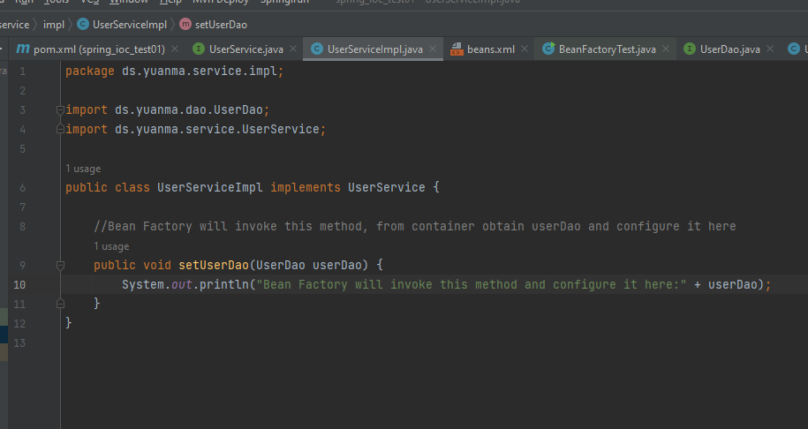

Slide 10
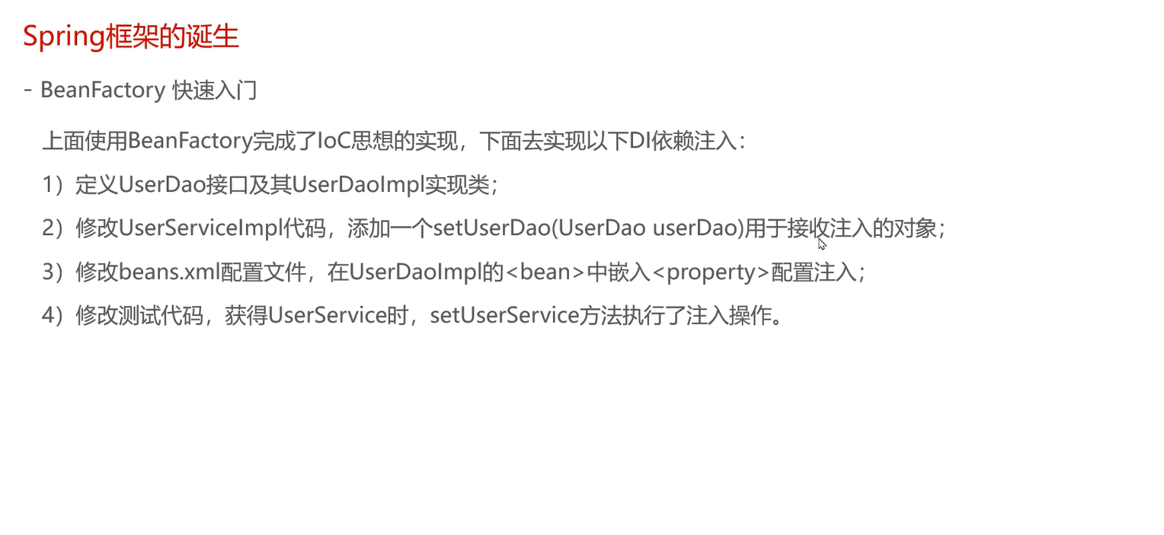

Slide 11
Application Context

Slide 12
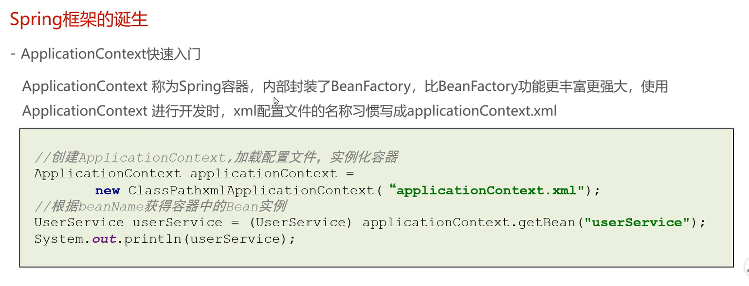

Slide 13
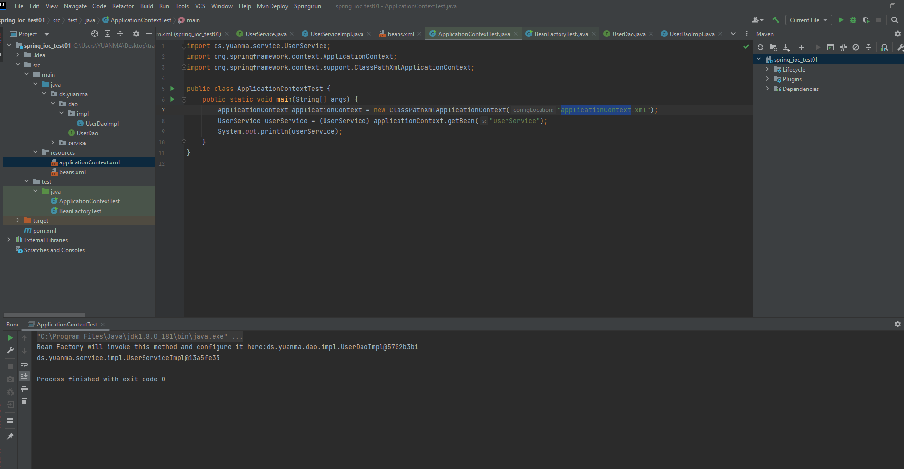

Slide 14
BeanFactory and ApplicationContext
Relationship & vs

Slide 15
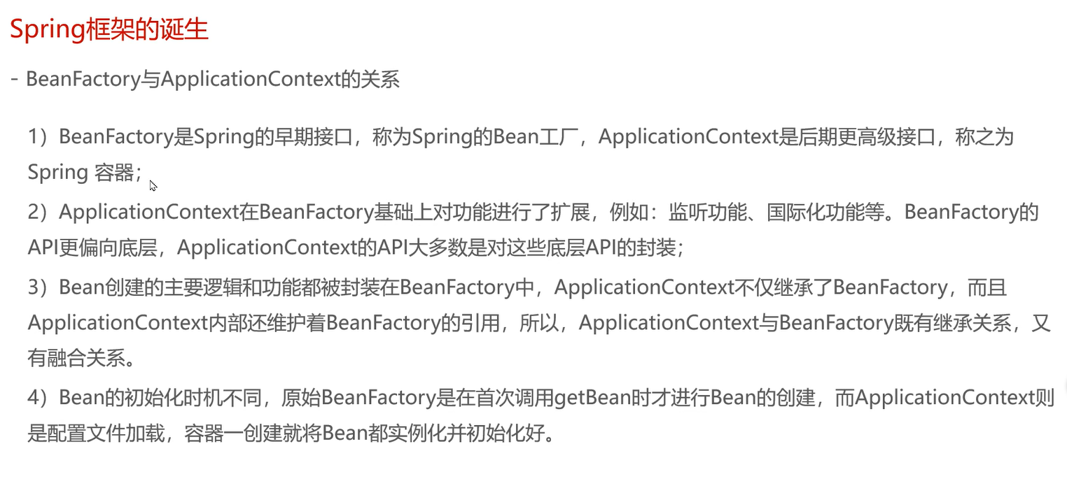

Slide 16
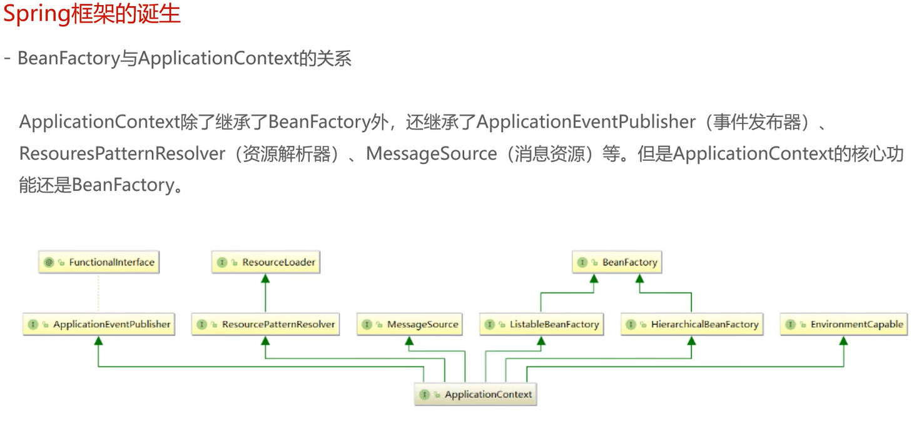

Slide 17
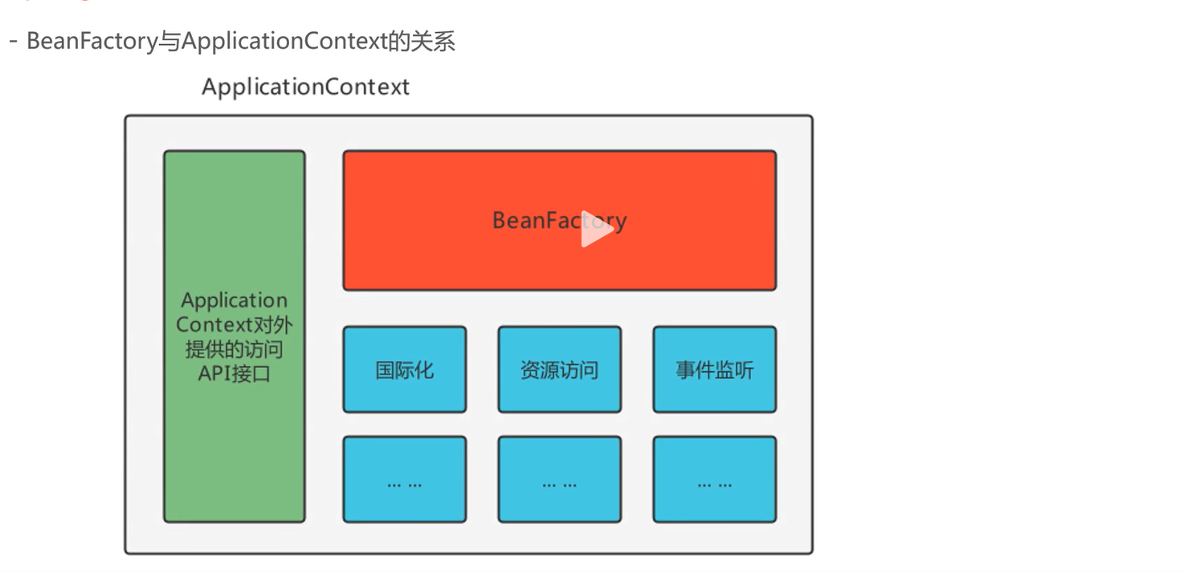

Slide 18
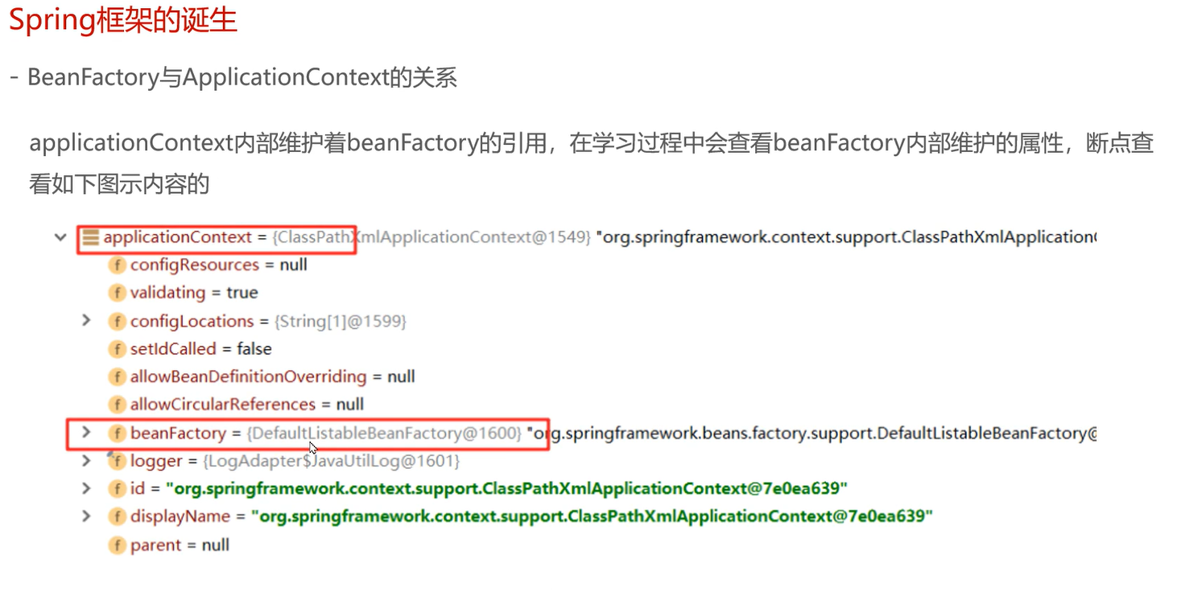

Slide 19
BeanFactory Inherit

Slide 20
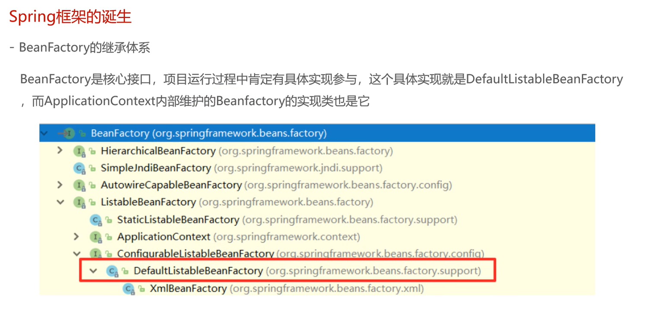

Slide 21
ApplicationContext Inherit

Slide 22
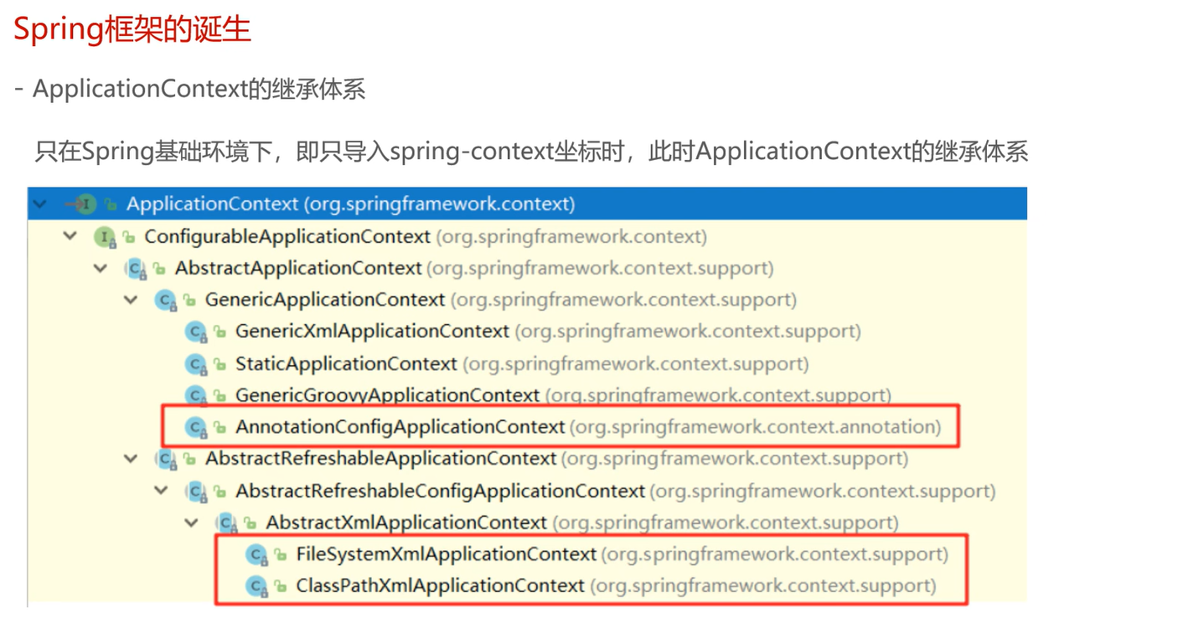

Slide 23
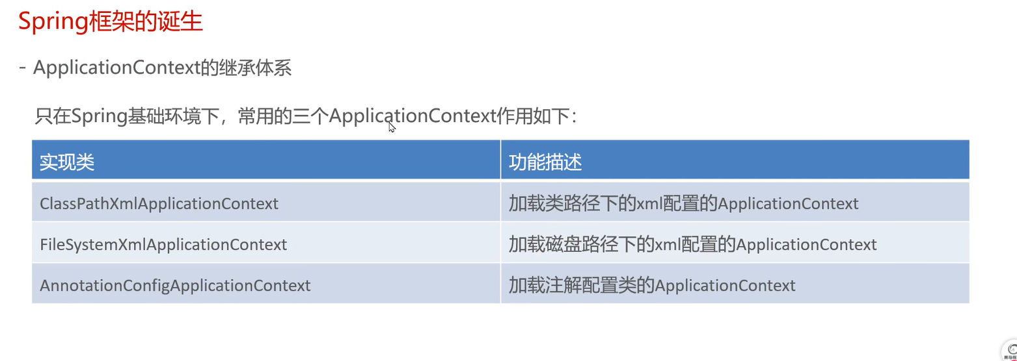

Slide 24
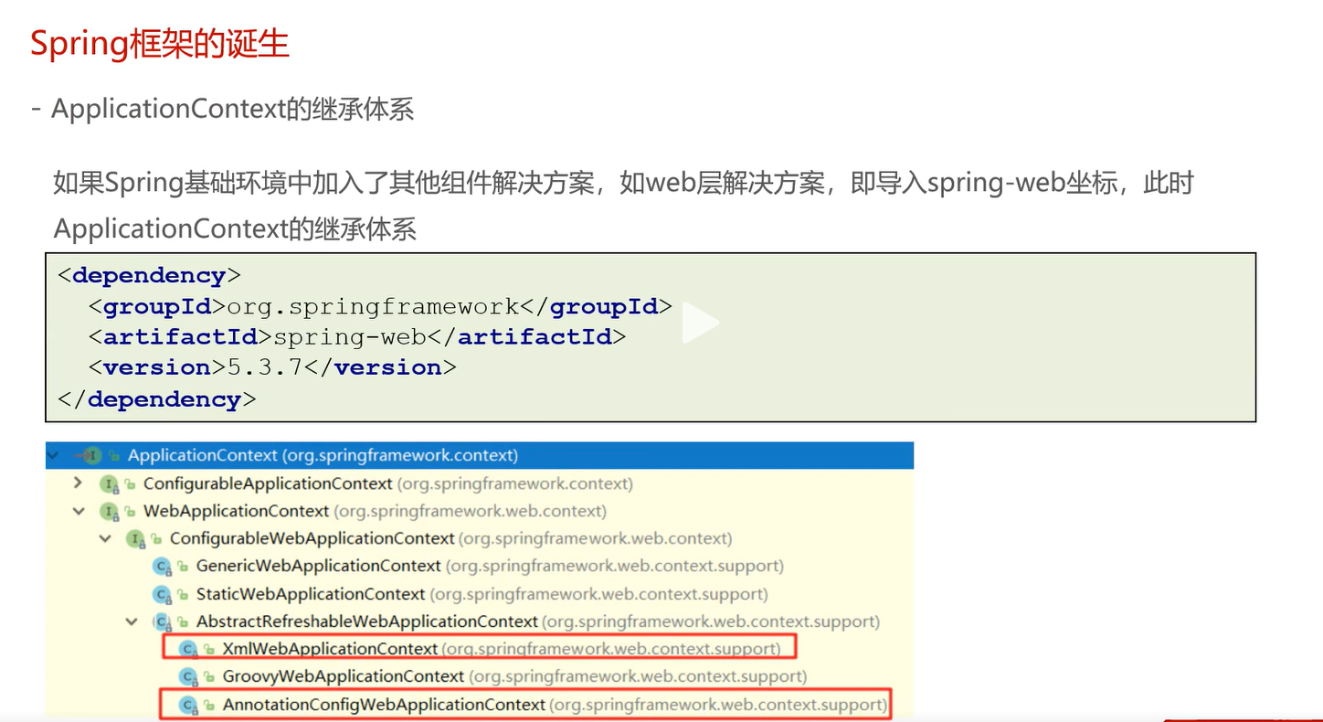

Slide 25
Xml Spring Application

Slide 26
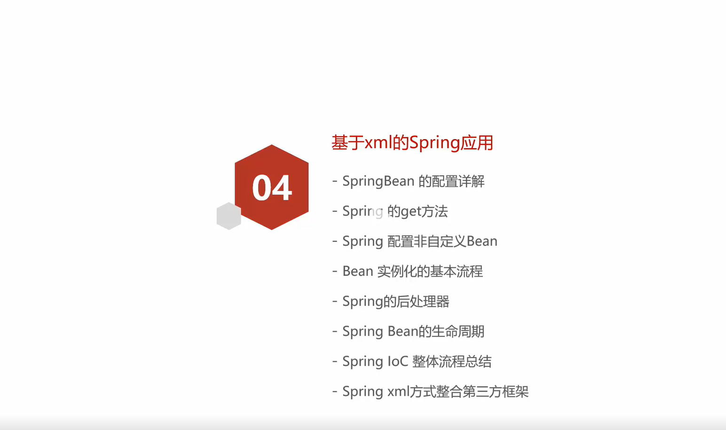

Slide 27
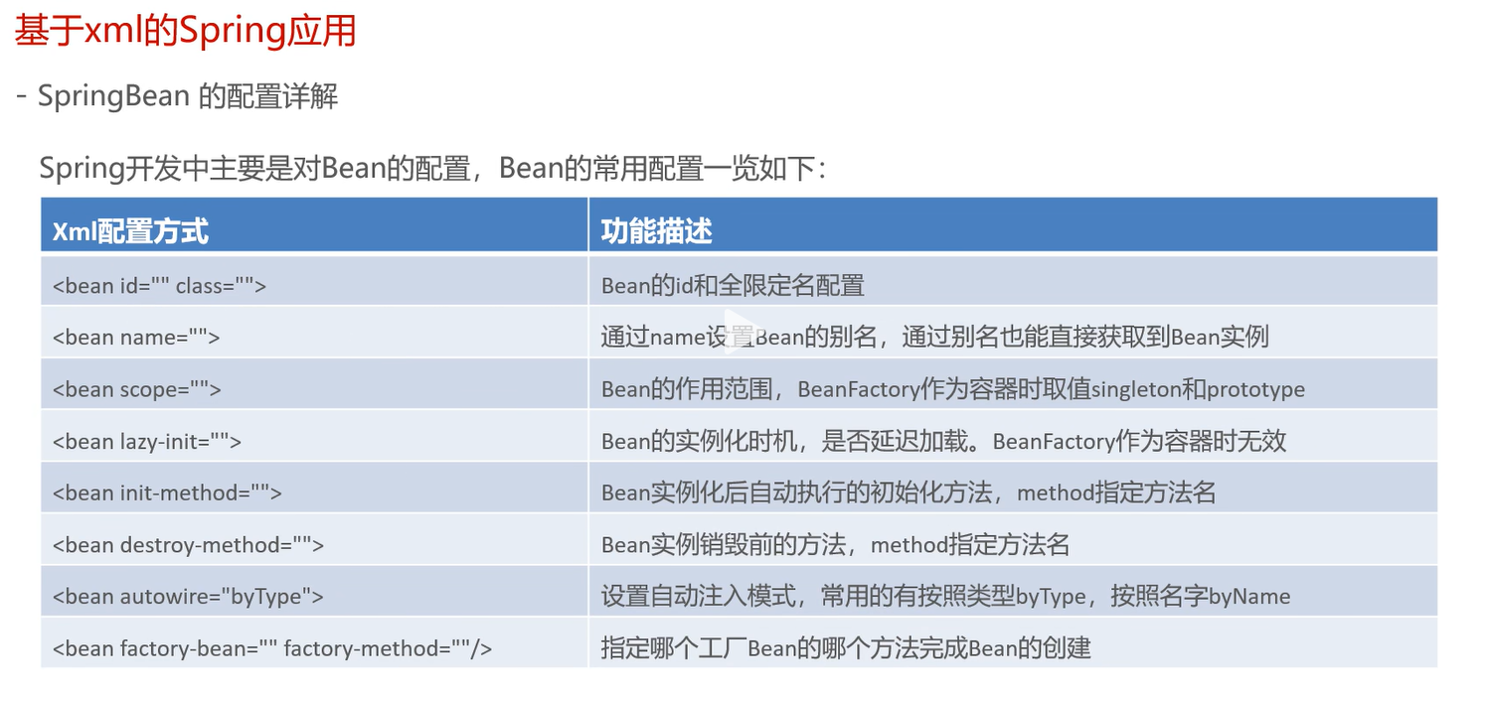

Slide 28
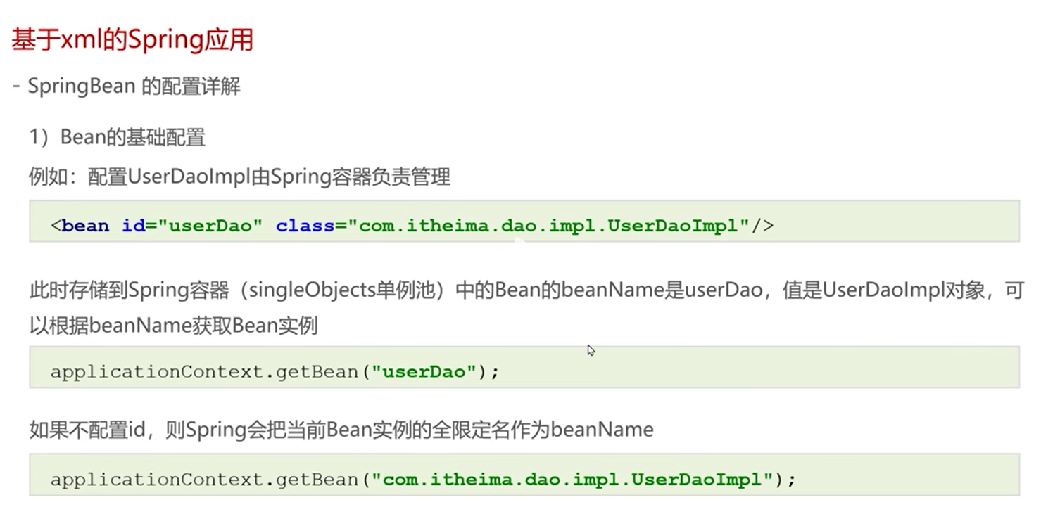

Slide 29
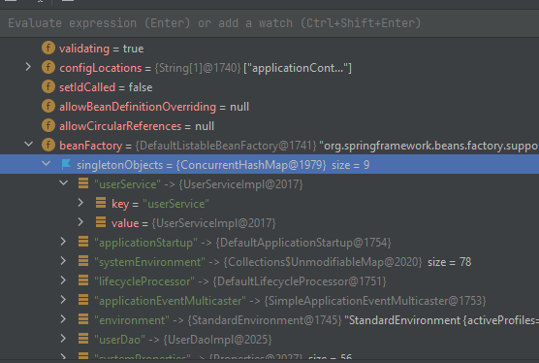
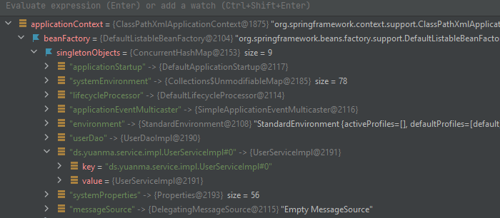
<bean id=“” class=“”> : Alias
Id will be converted as bean name
ClassPathXmlApplicationContext.getBean will get by bean name
Bean id
Bean name
applicationContext.getBean(“Bean name”)
If Bean id is defined
If Bean id is not defined
<bean class="ds.yuanma.service.impl.UserServiceImpl">

Slide 30
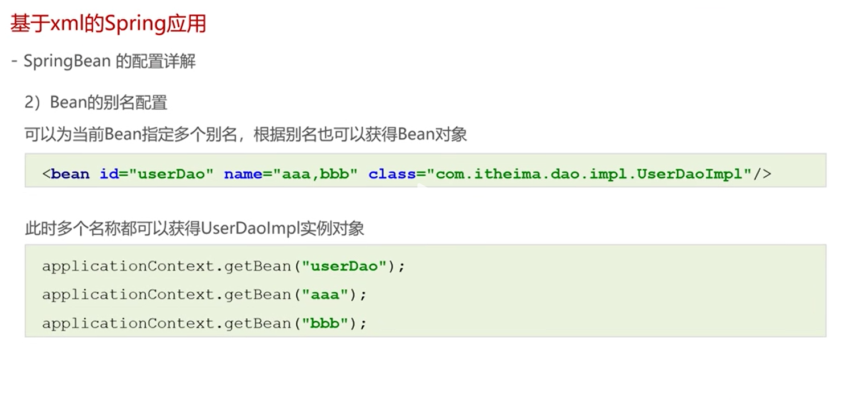

Slide 31
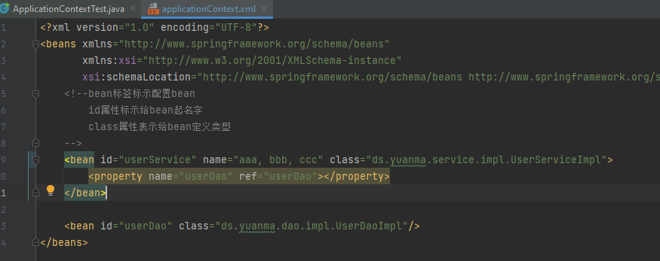
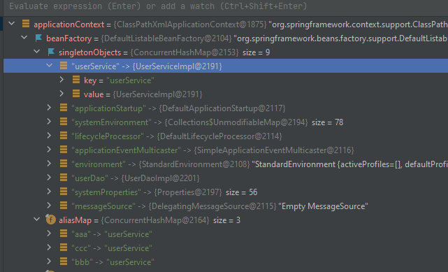
<bean name=“”> : Alias
If id is defined, the default Bean name is bean id
If id is not defined, but Bean name is defined, the 1st name is the Bean name

Slide 32
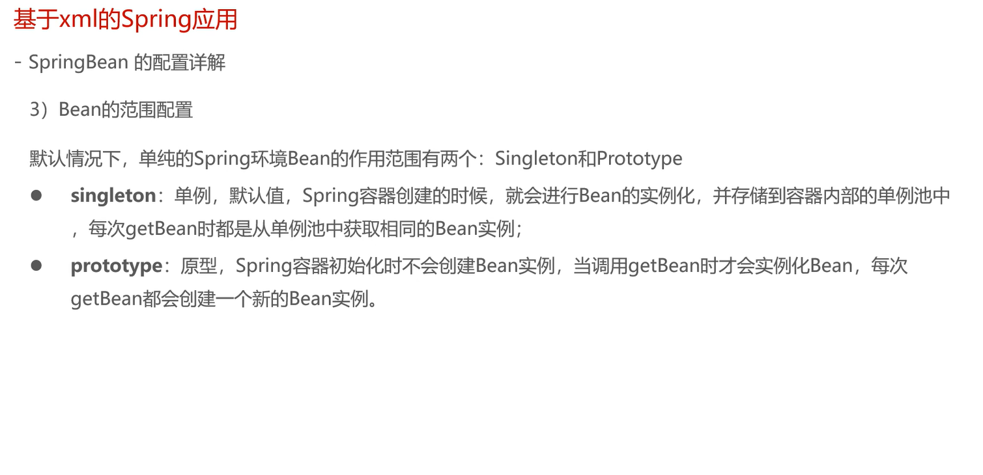

Slide 33
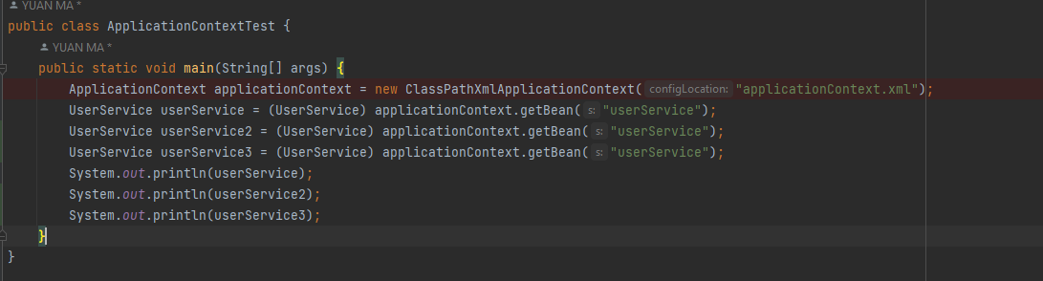
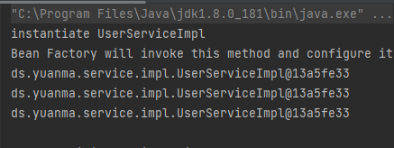
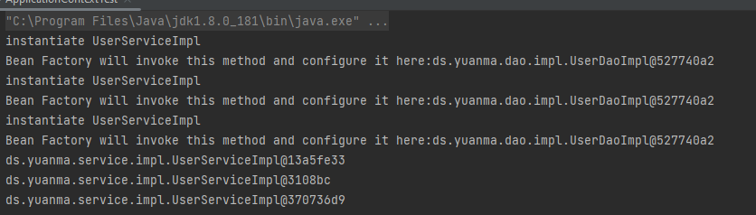
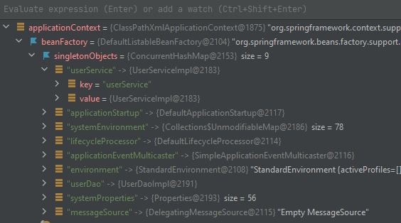
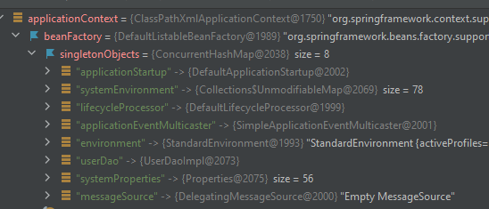
<bean scope=“singleton | prototype”> (spring-context)
If add dependency: spring-webmvc
Singleton
Prototype
Request
session
<bean scope=“singleton”>
<bean scope=“prototype”>
No service in <singletonObject> Pool!

Slide 34
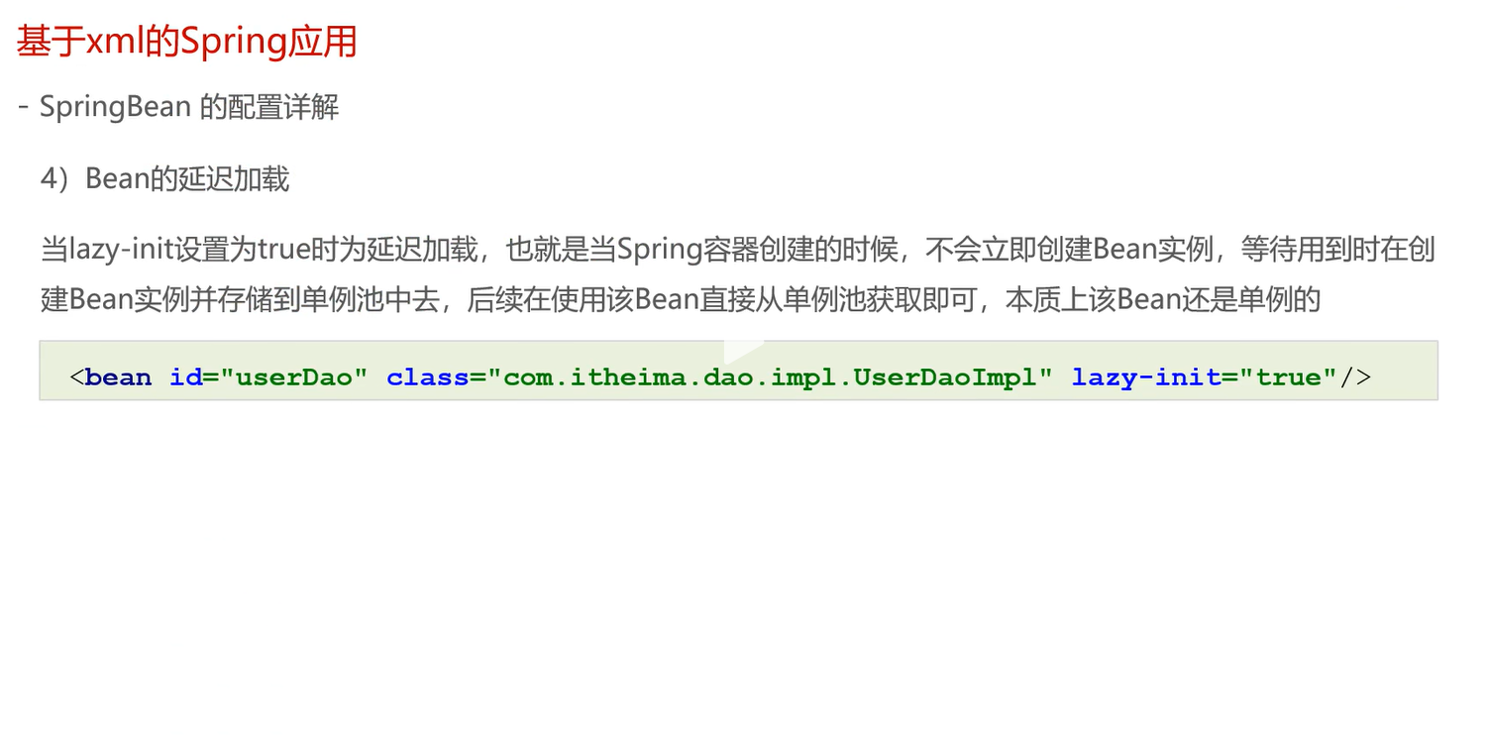

Slide 35
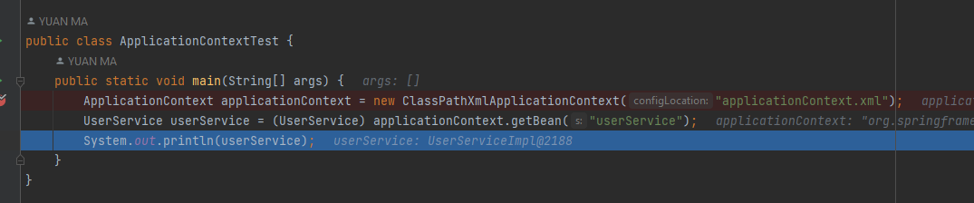
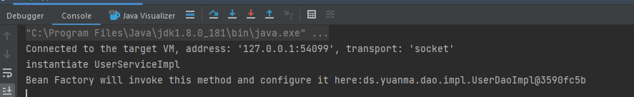
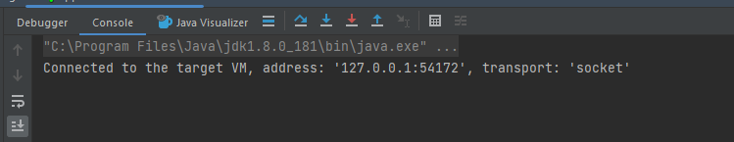
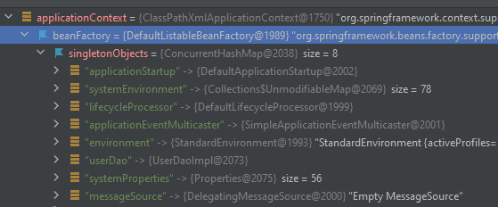
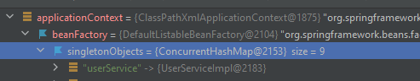
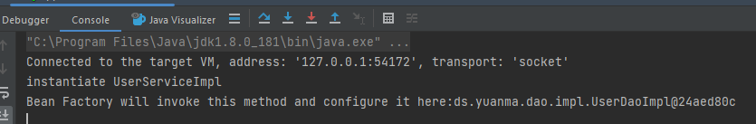
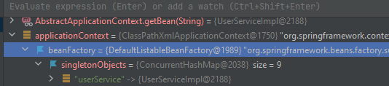
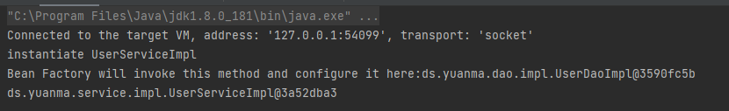
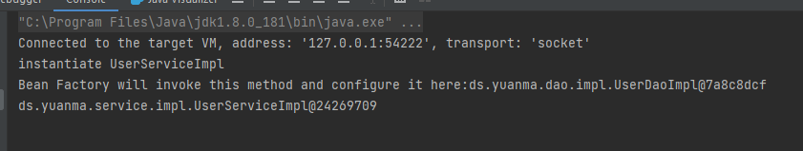
<bean lazy-init=“true | false”>
Not applicable for BeanFactorty
BeanFactory by default is lazy-inity
1
2
3
Execution seq
<bean lazy-init =“false”>
<bean lazy-init =“true”>
1
2
3

Slide 36
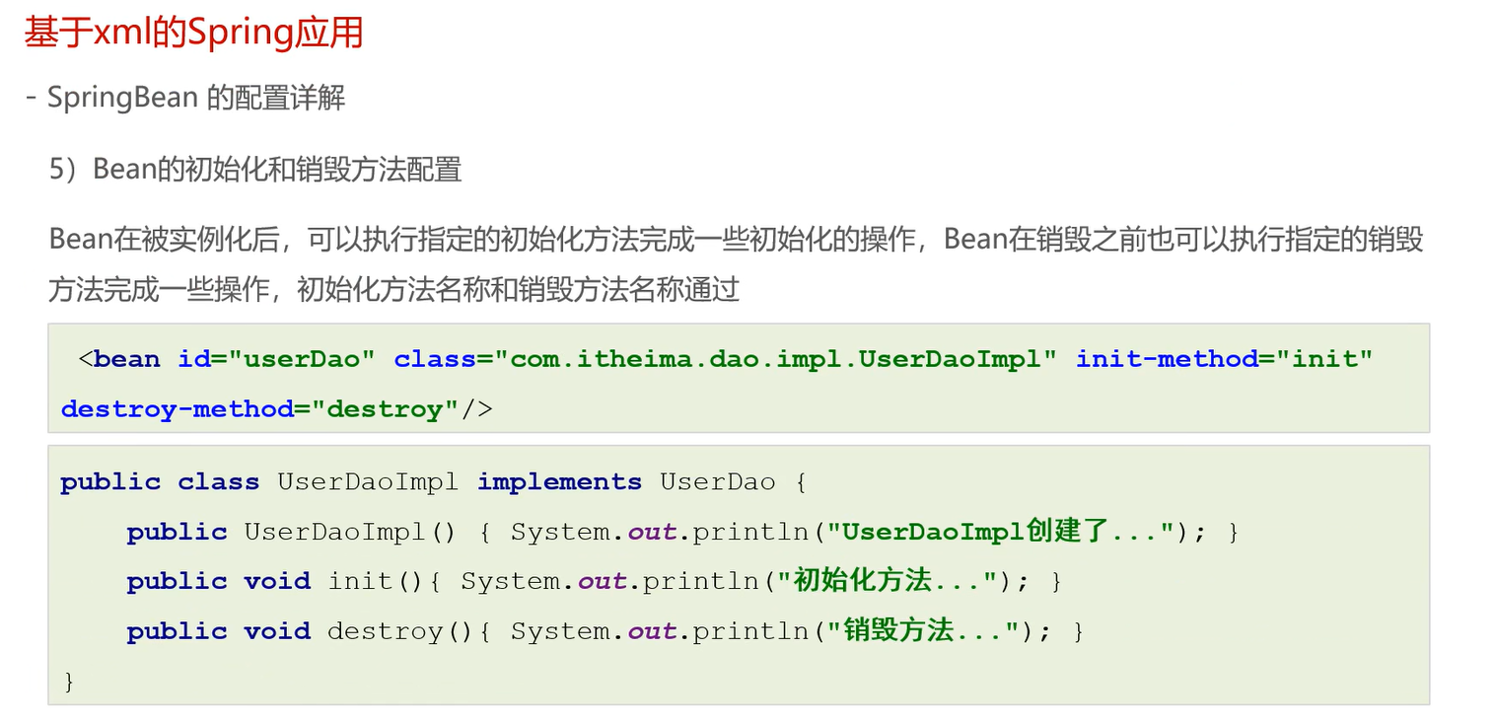

Slide 37
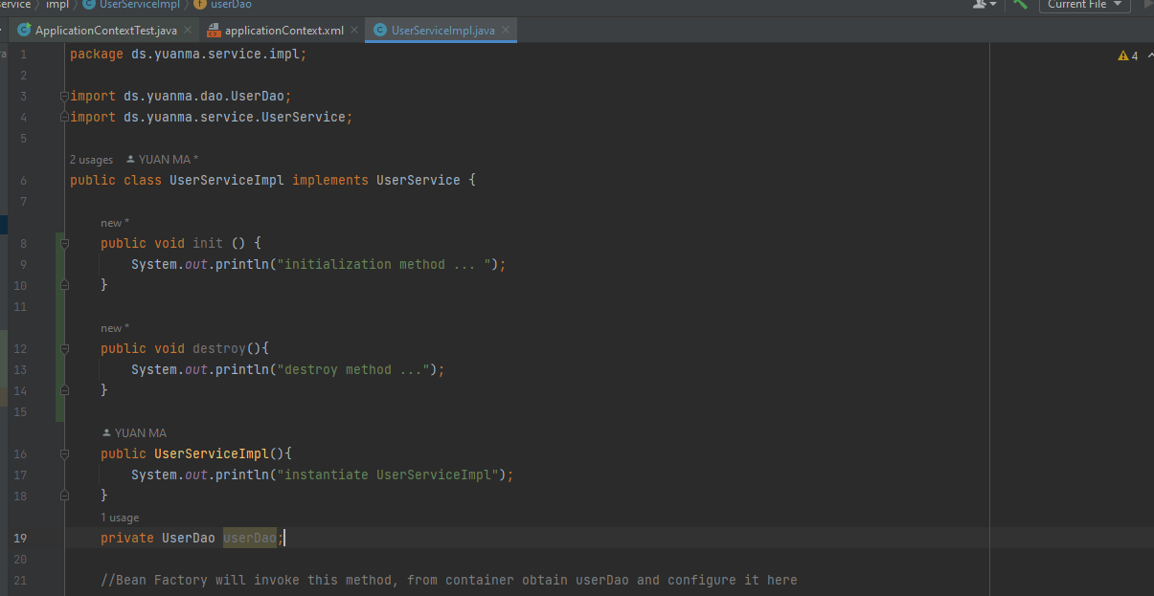
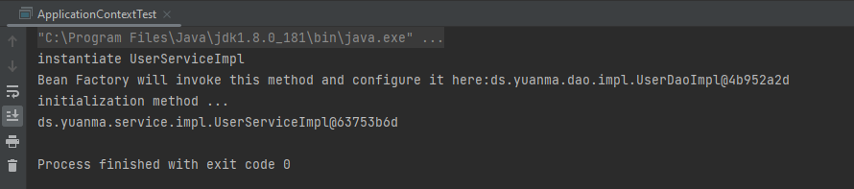
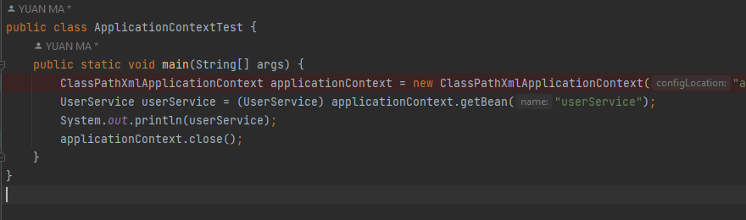
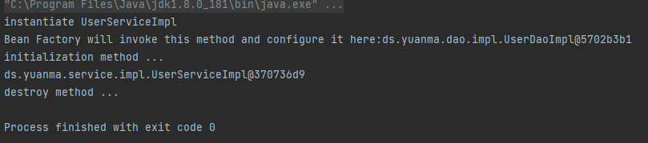
<bean init-method="" destroy-method=" “>
instantiate
Init()
To destroy

Slide 38


1. Instantiate bean object
2. Set properties for bean
3. Init after properties set
4. Init method

Slide 39


Slide 40


Slide 41


Slide 42





Slide 43




Slide 44






Slide 45


Slide 46


Slide 47


Slide 48


Slide 49


Find set{Name}; where set property name allocated

Slide 50


Find property type allocated
Cannot Find which one to be allocate and wire to

Slide 51


User defined

Slide 52


Slide 53


Slide 54


No space!!!

Slide 55


Slide 56


Slide 58


Slide 59



